Slide 1


Tweets world during Champions League
Damian Kluba, Łukasz Opioła

Slide 2
Goals of the project
Find proper events,
Prepare hashtags,
Implement scripts which are using Twitter Streaming API,
Choose interesting matches,
Query database for interesting data,
Create graphs and charts depicting significant features of analyzed data.

Slide 3
Gathering data
Twitter Streaming API,
Prepared 44 hashtags related to champions league and matches,
Collecting data for almost 3 days (21.10 - 23.10),
Got 1,784,265 tweets from 674,460 users,
2,739,238 hashtags used in those tweets,
53 languages used.

Slide 4
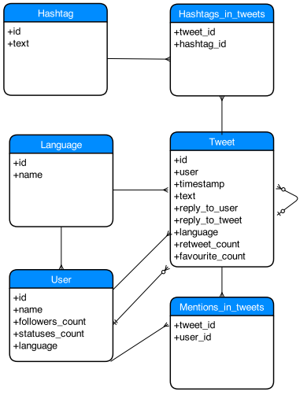
DB Schema

Slide 5
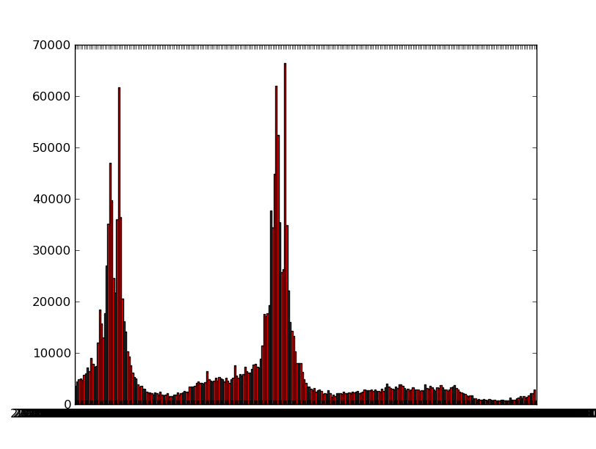
Tweets over time

Slide 6
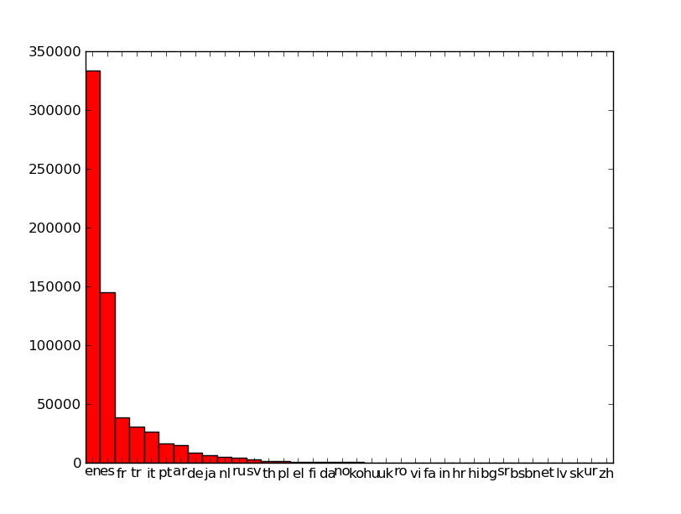
Statistics
most popular languages
languages histogram
en: 333,249
es: 145,123
fr: 38,499
tr: 30,207
it: 25,995
pt: 15,981
ar: 15,104
de: 8,726
ja: 6,528
nl: 5,151

Slide 7
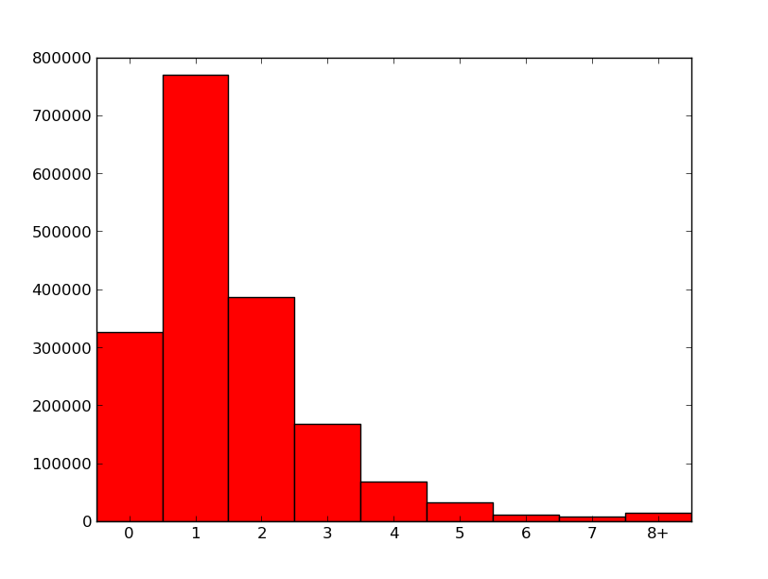
Statistics
most popular hashtags
hashtags histogram
#UCL: 399,384
#HalaMadrid : 267,256
#LFC : 159,313
#ChampionsLeague : 104,690
#RomaBayern : 78,728
#RealMadrid : 48,884
#Arsenal : 44,879
#PSG : 40,224
#LIVvsRealMadrid : 37,812
#Roma : 31,317

Slide 8
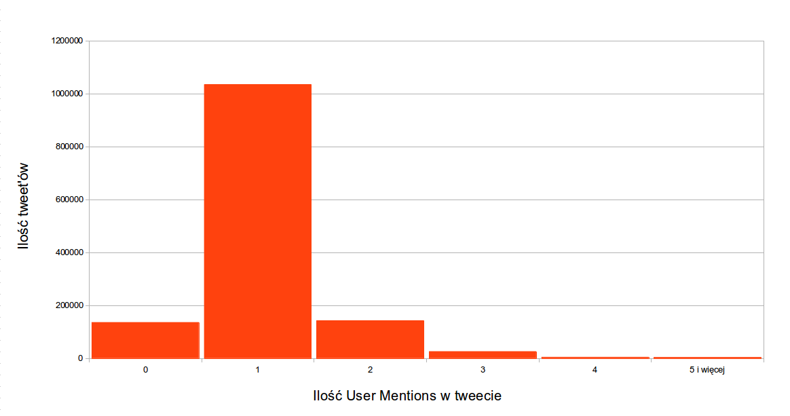
Statistics
most mentioned users
user mentions histogram
Champions League: 99,393
Real Madrid C. F: 80,870
Liverpool FC: 48,971
Cristiano Ronald: 26,170
Metsut Ozil: 24591
MisterChip(Alex: 23,835
Real Madrid C.F.: 18,406
FC Barcelona: 18,395
Chelsea FC: 17,464
Gareth Bale: 16,994

Slide 9
Data analysis
Picked two most optimistic matches – AS Roma vs FC Bayern and FC Liverpool vs Real Madrid,
Analized user mentions,
Analized retweets (standard numbers plus groups in Gephi and CFinder),
Analized chosen groups.

Slide 10
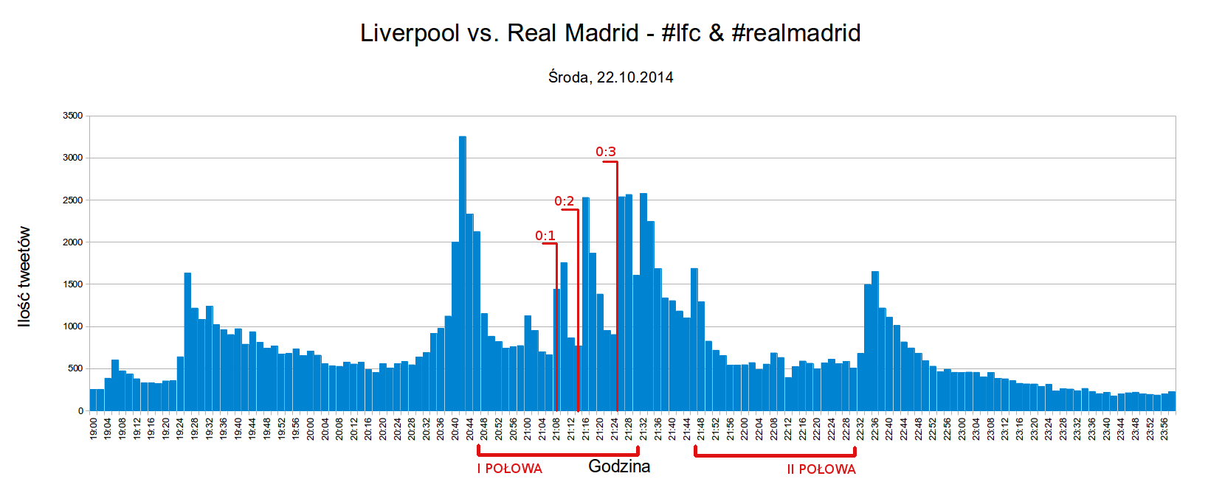
Liverpool : Real

Slide 11
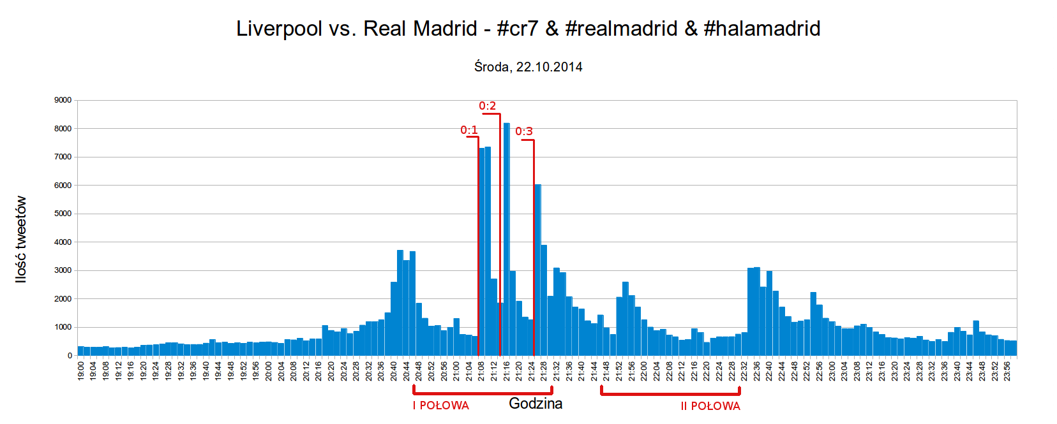
Liverpool : Real

Slide 12
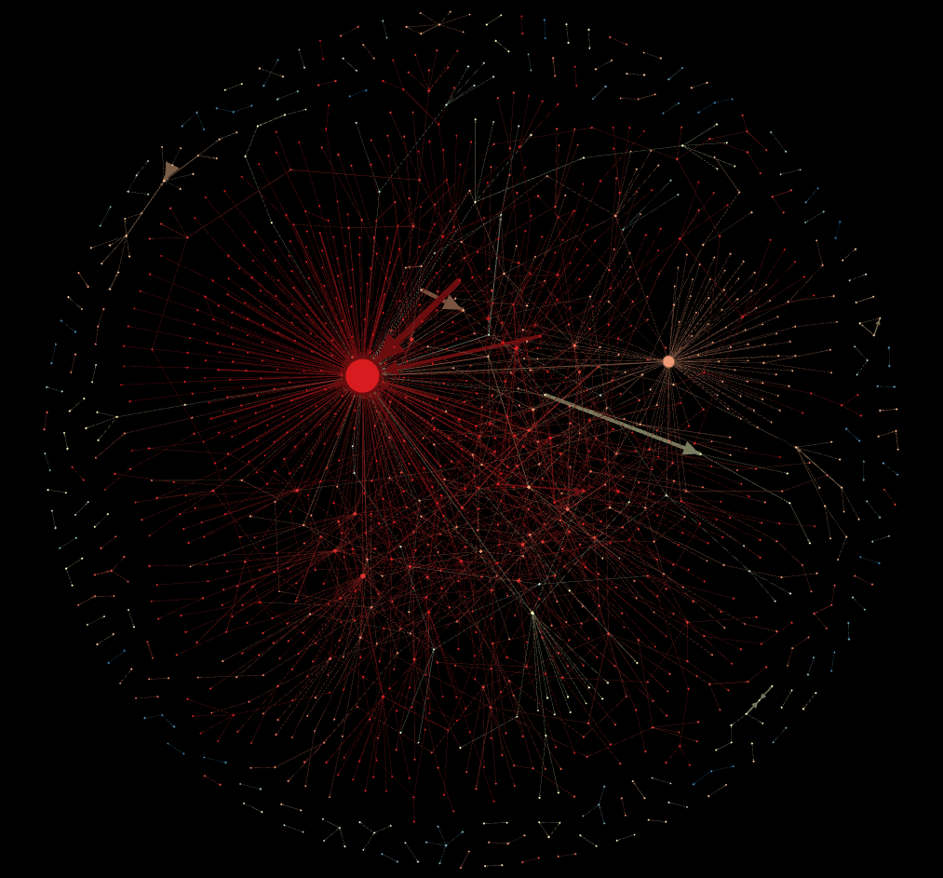
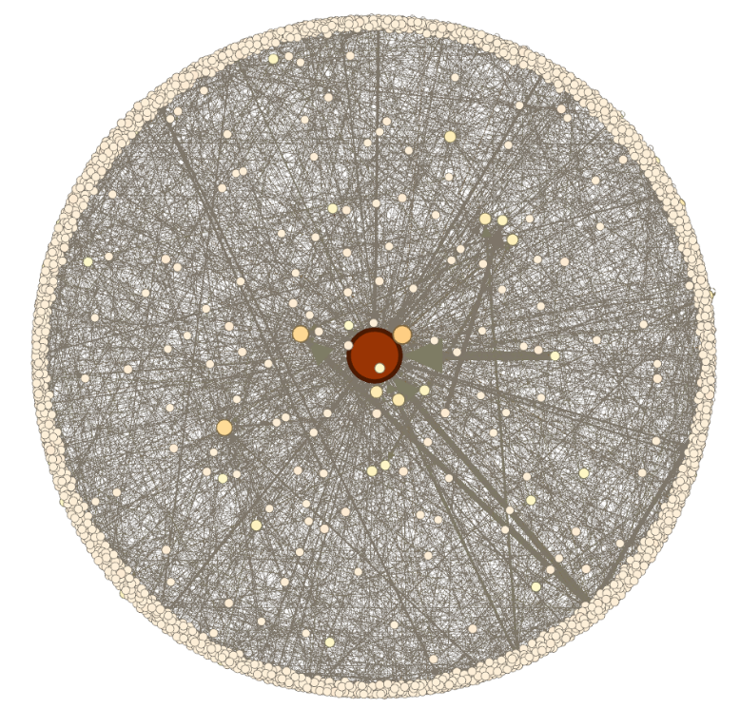
Liverpool : Real
retweets
user mentions

Slide 13
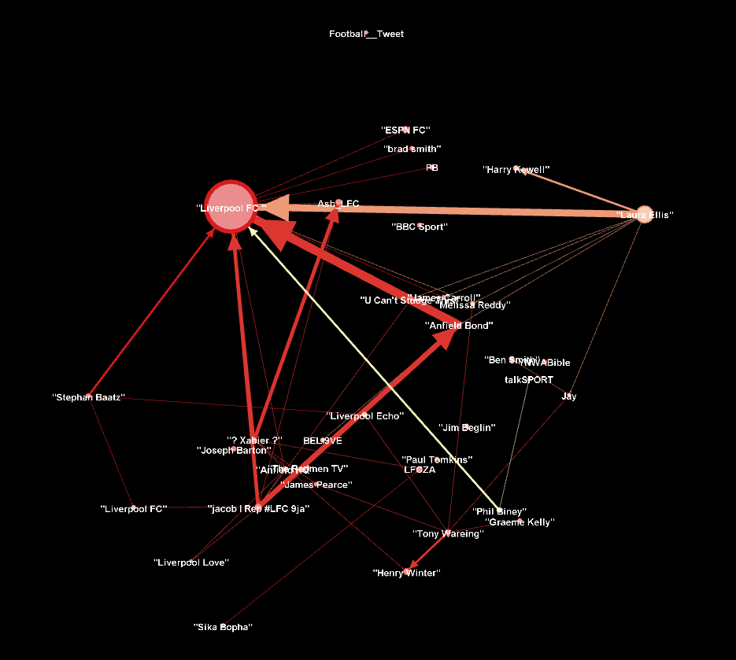
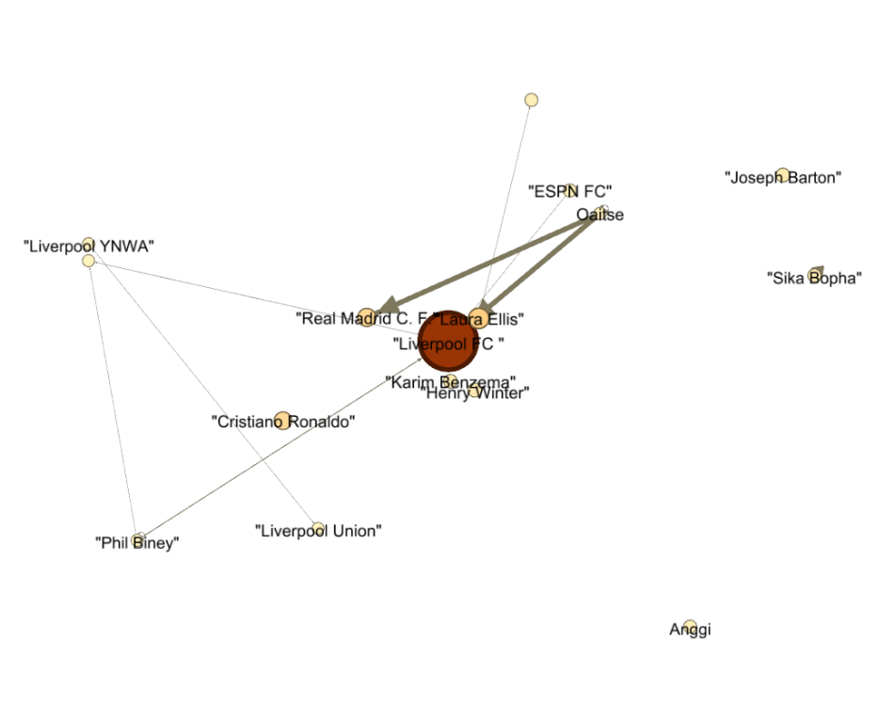
Liverpool : Real
retweets (k>10)
user mentions (k>20)

Slide 14
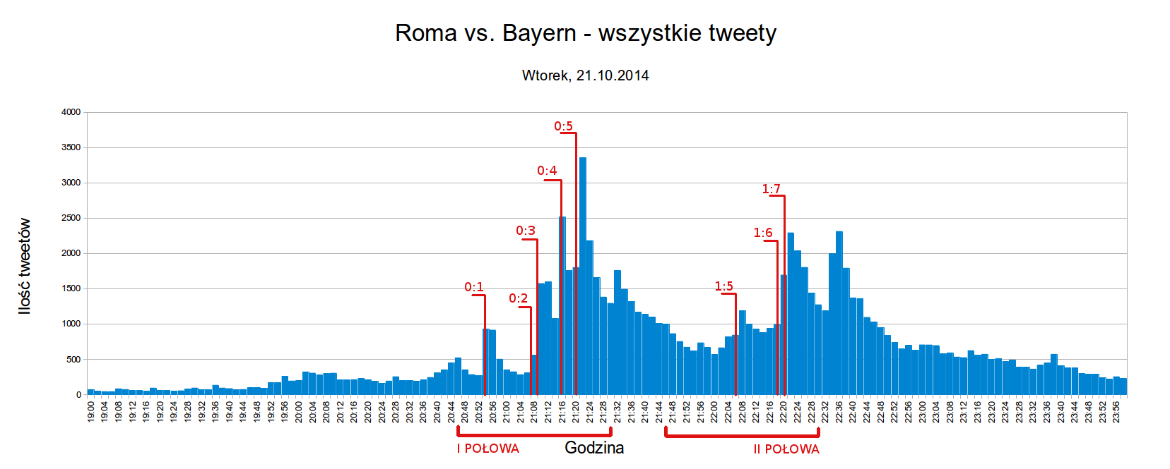
Roma : Bayern

Slide 15
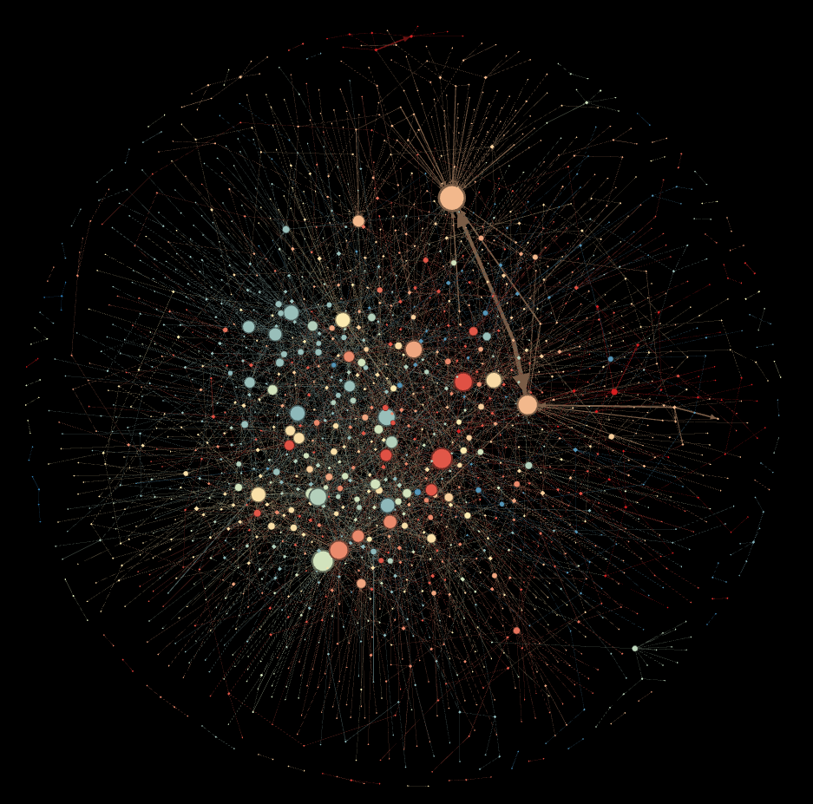
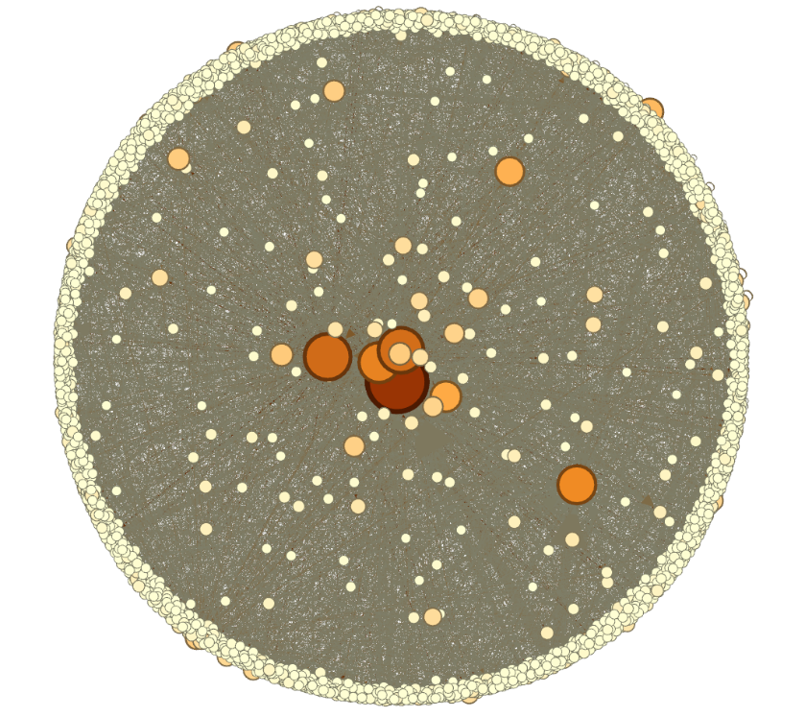
Roma : Bayern
retweets
user mentions

Slide 16
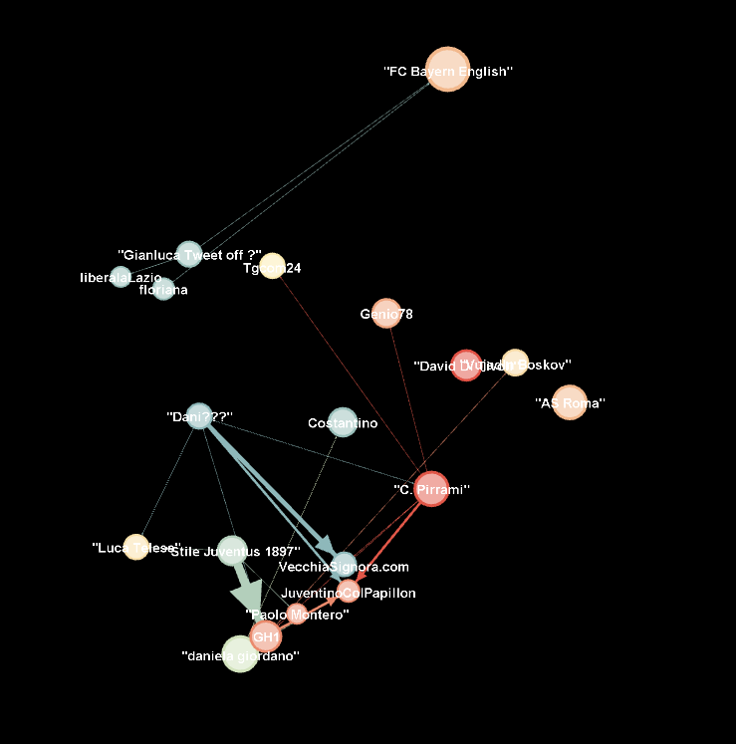
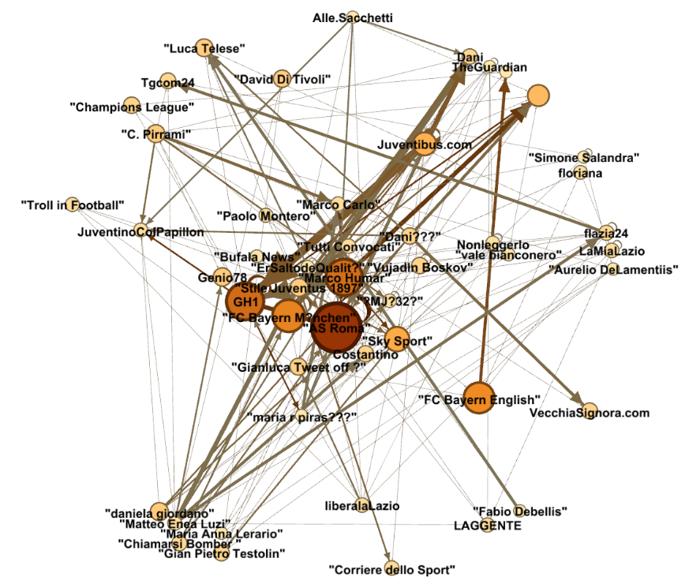
Roma : Bayern
retweets (k>20)
user mentions (k>25)

Slide 17
Conclusions
Hashtags and user mentions are very popular on twitter platform (1/6 of tweets didn’t have hashtag, 30% of tweets didn’t mention anybody),
Users quickly responds on twitter after some events,
„reply to” option is rarely used on twitter in comparison to user mention,
Social networks between italians are bigger than germans, english or spanish,
It’s really important to choose proper keywords to search for data like this.

Slide 18
What can be done
Download additional data through REST API (for example, the database misses source tweets of some retweets),
Search for dependencies between matches,
Similar research on data from final match to see how the prestige of the event affects twitter’s traffic.

